Slide 1
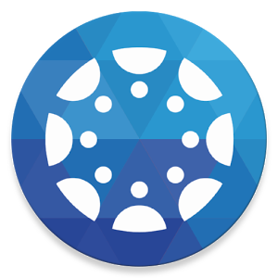
The Canvas Parent App
Install the Canvas Parent App on Android Devices
(Android smart phones or tablets)
Install the Canvas Parent App on iOS Devices
(iPhone or iPad)

Slide 2
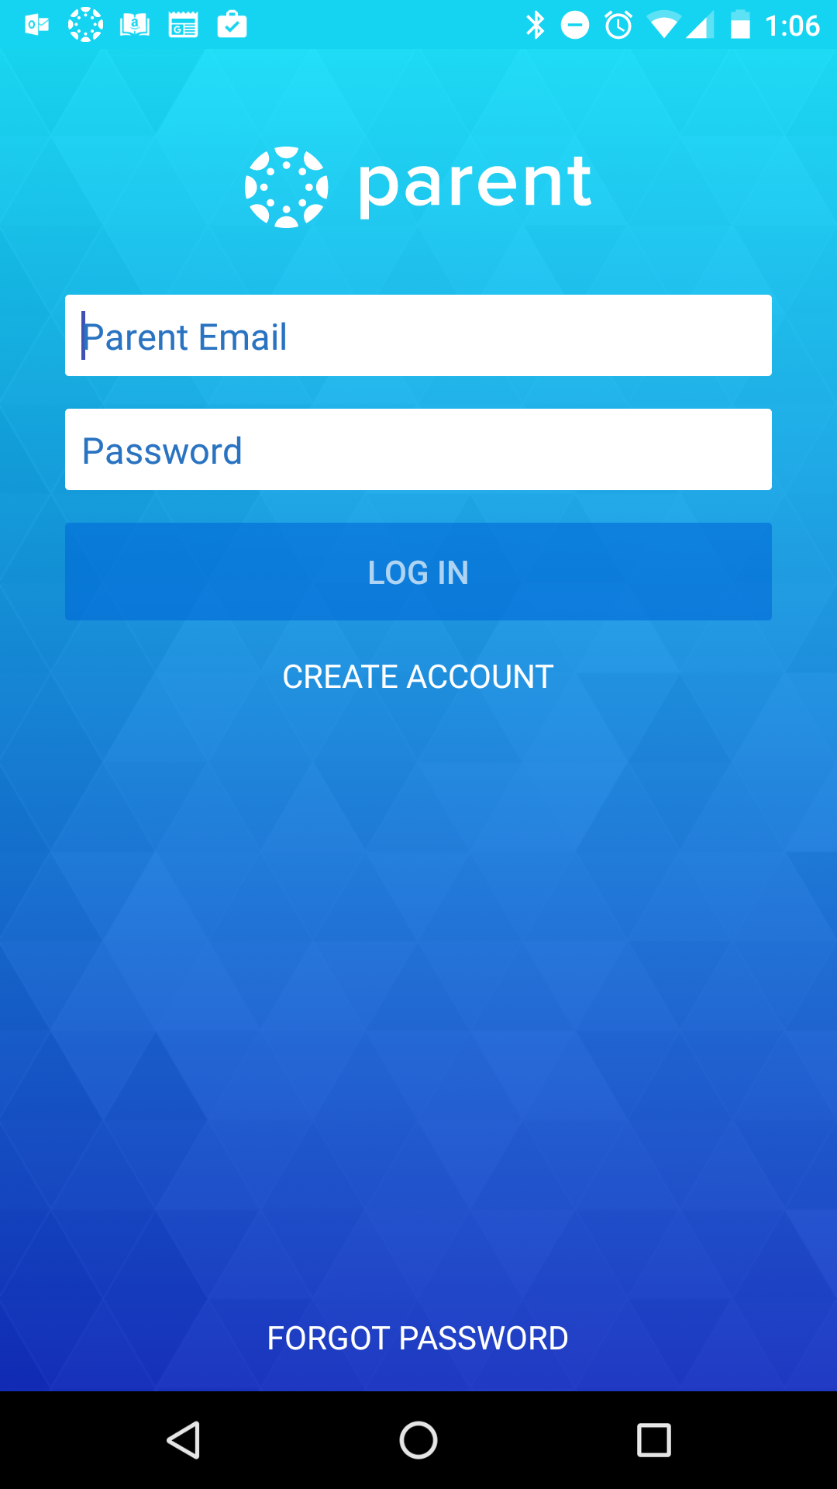
First Time Accessing
The Parent App
Select "CREATE ACCOUNT" the first time you access the app.
Once you have created your account, you can log into the parent app from any device.

Slide 3
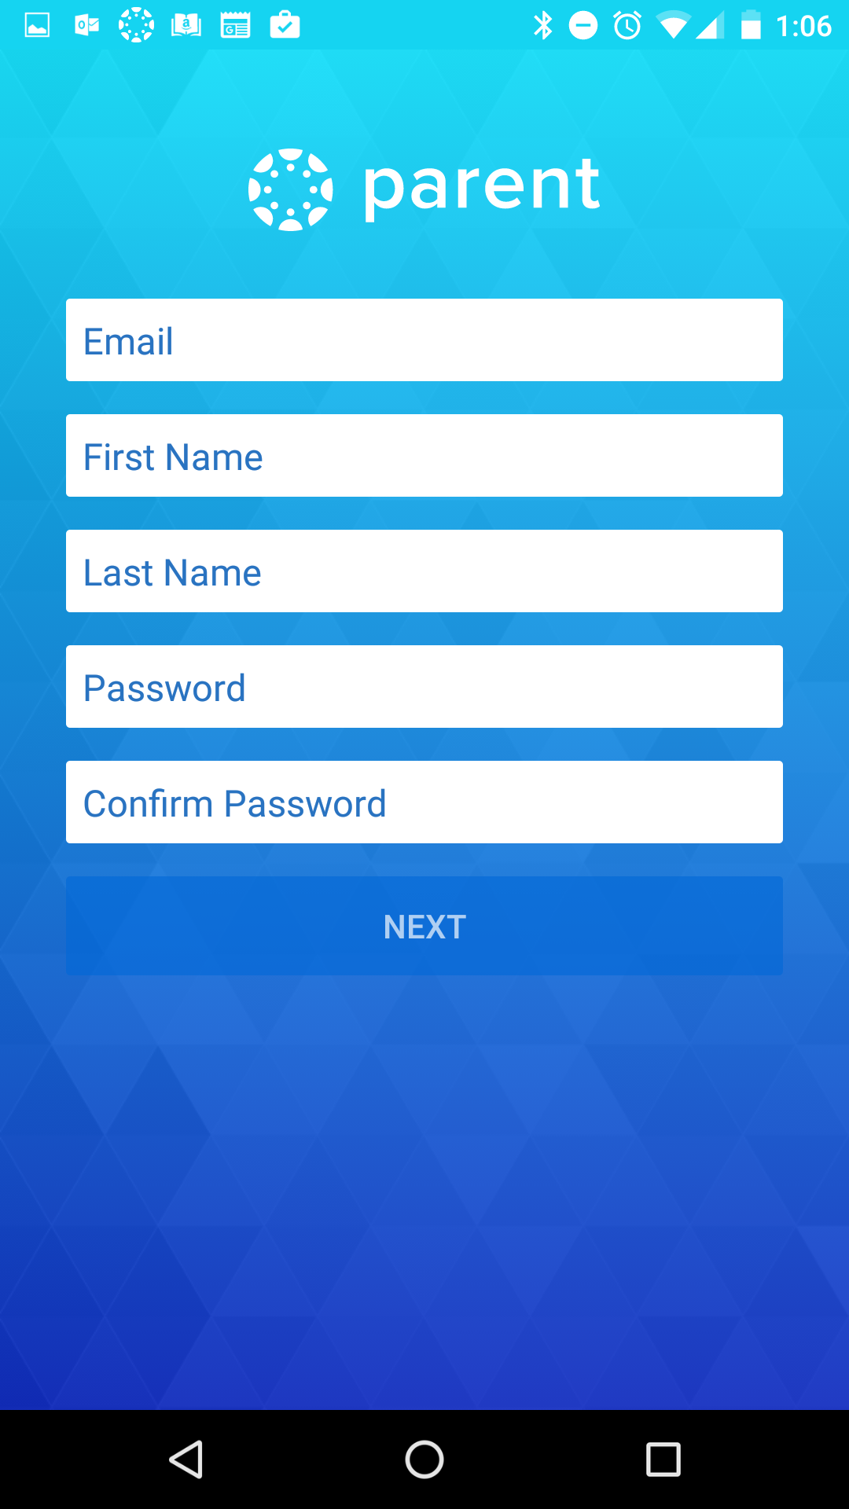
Create your account
Select a secure password you can remember and make sure you enter your email address correctly.
CMS will not be able to help you recover your password but you will have an option to have a reset link emailed to you.

Slide 4
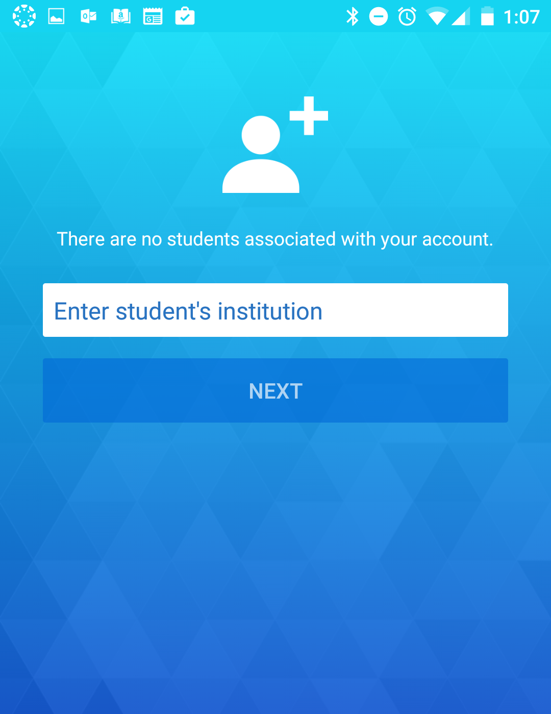
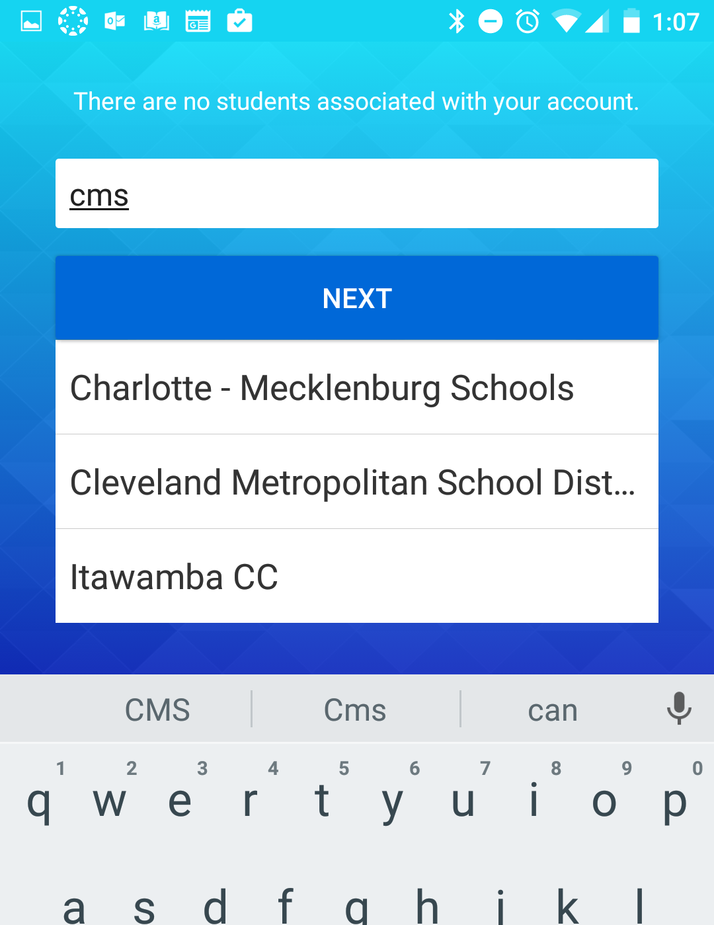
Enter student's institution
Enter "cms" in the "student's institution" field.
Choose Charlotte-Mecklenburg Schools

Slide 5
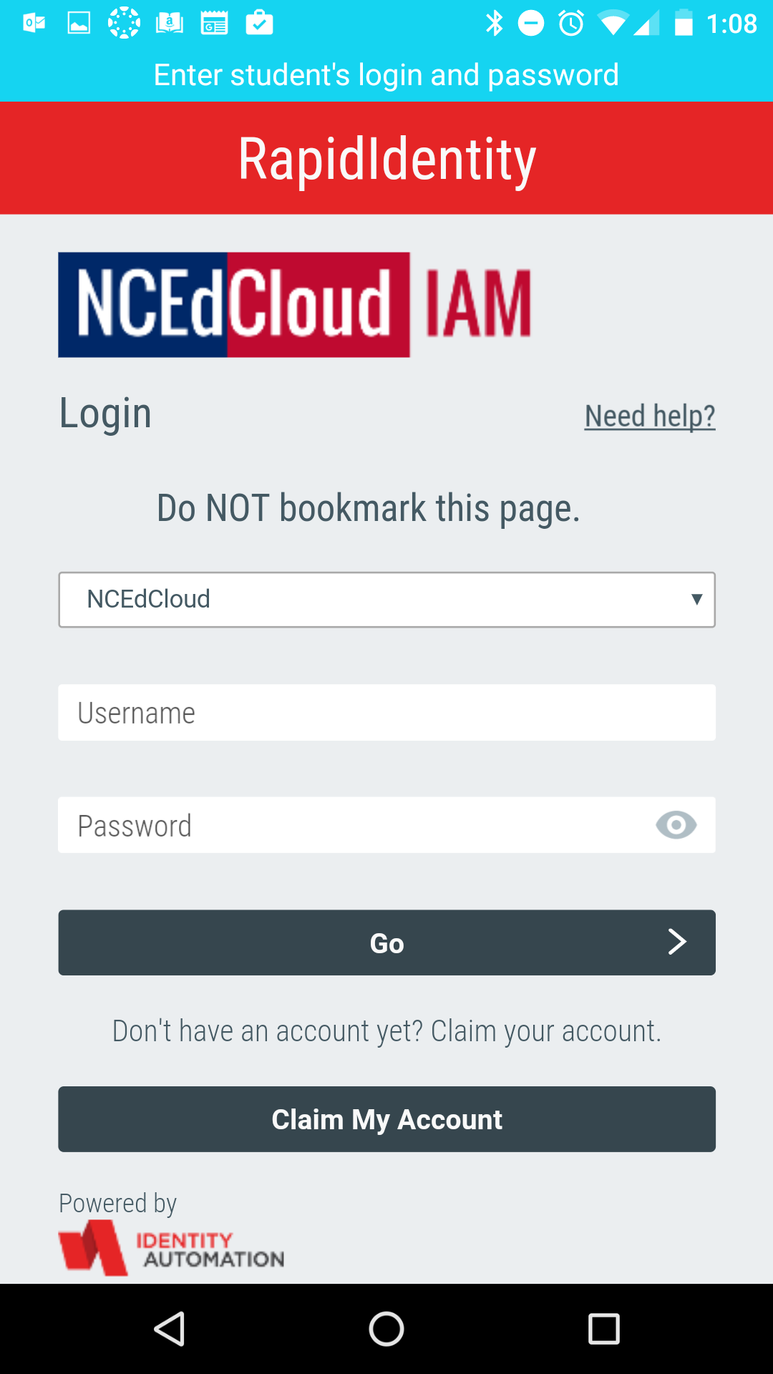
Enter your student's login and password
Your student's Username is their studentID.
Your student will probably know their password, but if they do not, their teacher can help reset the password and communicate it to you.

Slide 6
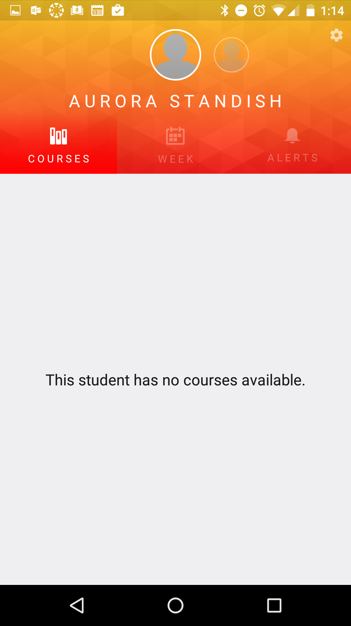
Your student's courses
You may not see any courses if the teacher has not published their course for your student to see it.
When courses are available, you will be able to see assignment details such as due dates as well as your student's work submitted for that assignment.

Slide 7
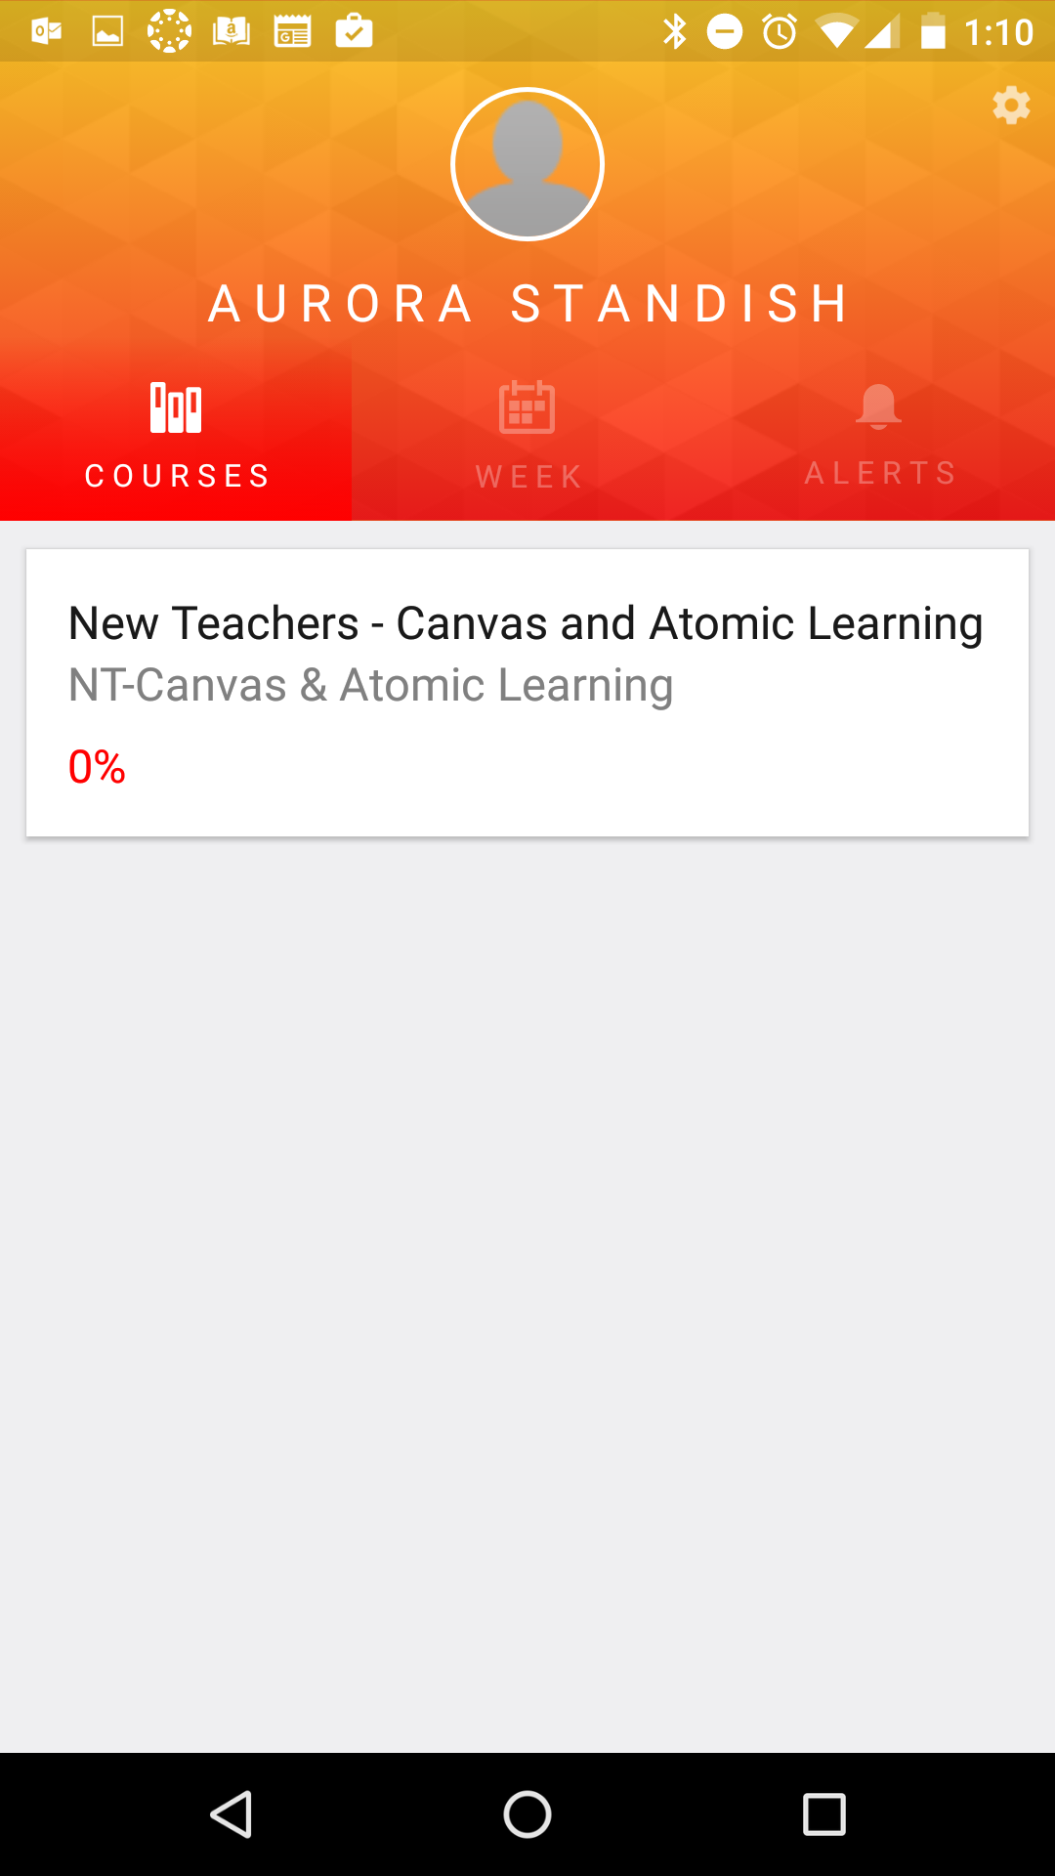
Adding another student
1
Touch the icon in the top right corner.
Touch the icon (android) or + icon (iOS)
Choose "Add Student"
Follow the previous slides to add your next student.
2
3

